Slide 1

Placement Sufficiency Strategy
2025 to 2030

Slide 2
Placement Sufficiency
The council has a legal duty under Section 22G of the Children Act 1989 to ensure that there is sufficient accommodation for children looked after that meets their needs, and that as far as is reasonably practicable is within
the local authority area.

Slide 3
Placement Sufficiency Strategic Aims
To invest and strengthen our edge of care offer to support children to continue living with their families
To support stability for our children and young people, by providing timely options to achieve permanence
To increase our recruitment and retention of mainstream and more specialist foster carers
To reduce our use of out of area children’s homes and IFA’s and increase our inhouse residential homes
To commission smarter to reduce costs, assure quality establishing stronger commissioning practices
To expand our provision of high quality semi-independent and independent accommodation working
Full details of our plans are shown in the Placement Sufficiency Strategic Delivery Plan, 2025 to 2030.

Slide 4
Children Looked After Population Needs Analysis
Number of Children Looked After has remained relatively stable
597 Children Looked After and 305 Care Leavers (18-21) March 2025
Number of Children Looked After per 10,000 is below the national average
Majority of children looked after live locally in the City or 20-mile radius
Average length of time that children remain looked after 2024 – 2025 is 31 months
Ethnicity of children looked after remains relatively stable
Ratio of Children from Abroad Seeking Safety increased but below national average
Gender ratio of male children looked after has increased slightly (CASS Impact)
Number of children with EHCP has increased

Slide 5
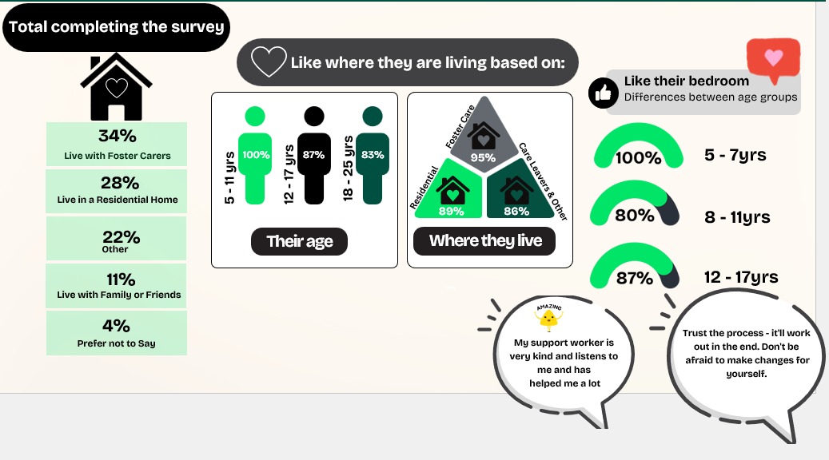
What Our Young People Tell Us – Leicester Asks Survey

Slide 6


Slide 7
Children Looked After Population Needs Analysis
Reasons Children become Looked After

Slide 8
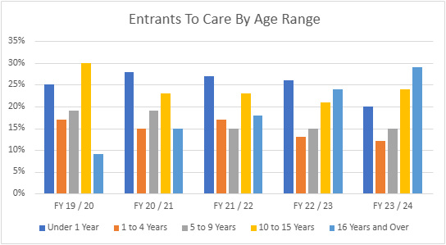
Children Looked After Population Needs Analysis
Entrants to care by Age

Slide 9
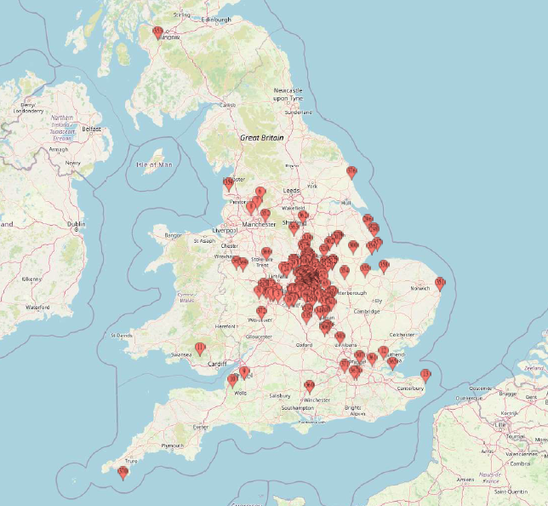
Children Looked After Population Needs Analysis
Where our children looked after live

Slide 10
Children Looked After Population Needs Analysis
Rate of children looked after per 10,000 is below national average

Slide 11
Numbers of Children Looked After per 10,000
Lower than East Midlands Unitary Averages

Slide 12
Children Looked After Population Needs Analysis
Ratio of male children has increased slightly
(children from abroad seeking safety)

Slide 13
Children Looked After Population Needs Analysis
Ratio of Children from Abroad Seeking Safety has increased but remains below comparators

Slide 14
Children Looked After Population Needs Analysis
Ethnicity of population group largely stable

Slide 15
Children Looked After Needs Analysis - Residential Care
Ratio of Leicester children living in residential care is below the national average
Number of our children placed in internal & external residential care has increased
Number of our children placed in internal residential care is above national average
Number of children placed in specialist residential care has increased
Average cost of residential placement has increased though below national average
Average cost of an internal residential placement is £4627 per week
Average cost of an external residential placement is £5414 per week
Average cost of specialist residential placement has increased
Number of children placed in unregistered placements is lower than average

Slide 16
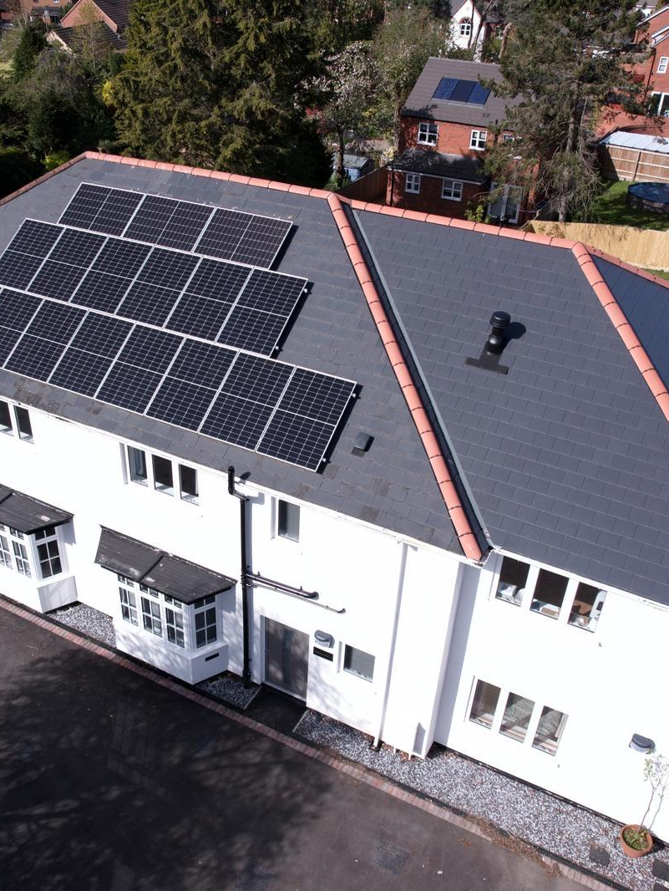
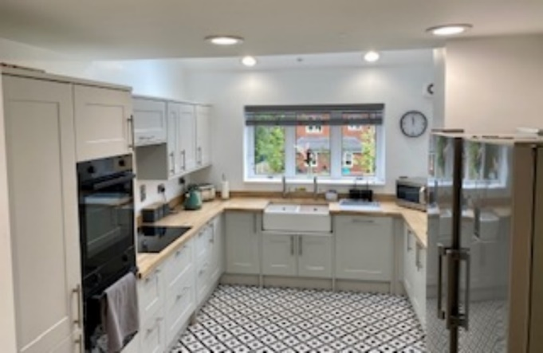
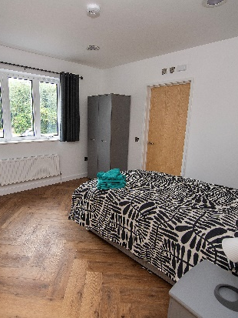
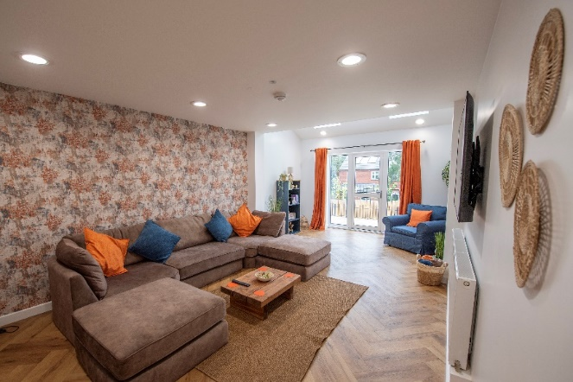
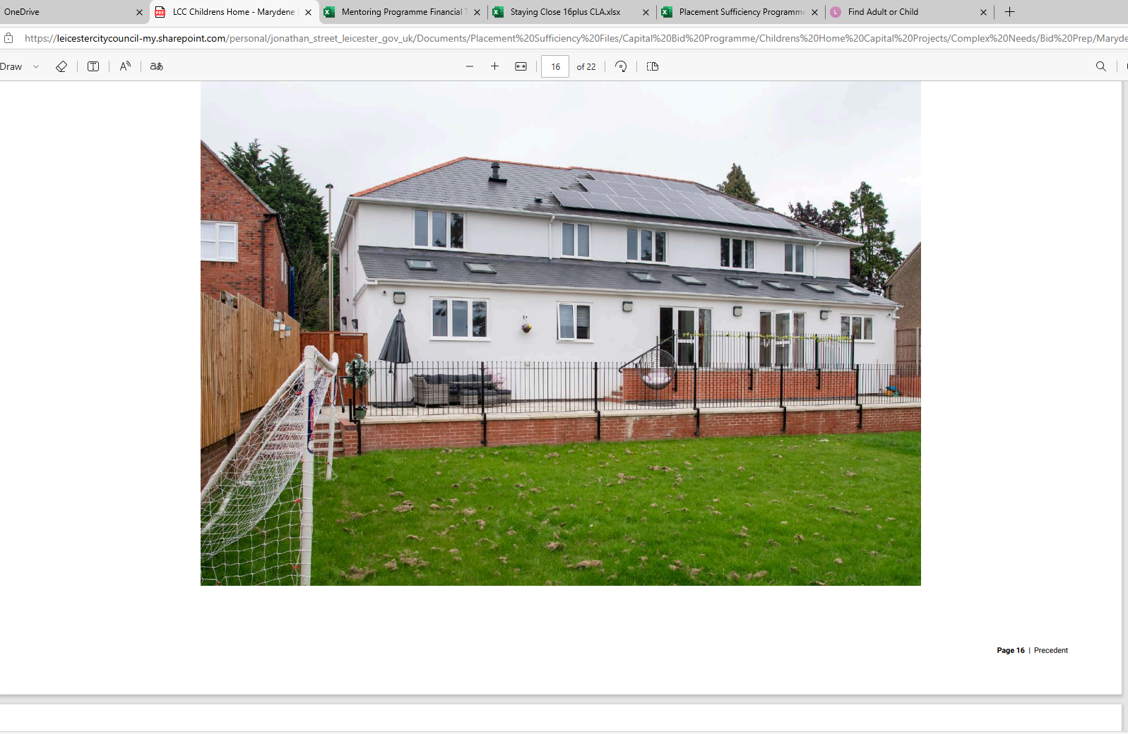
Holly House

Slide 17
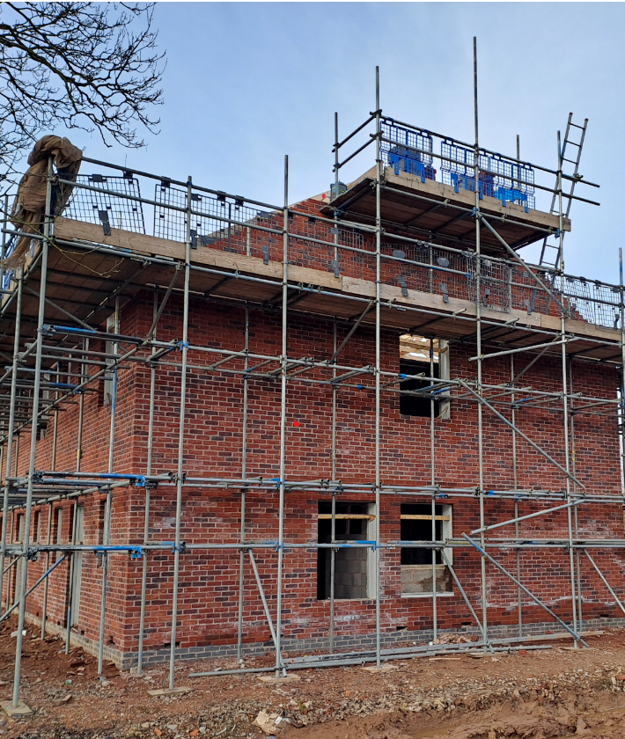
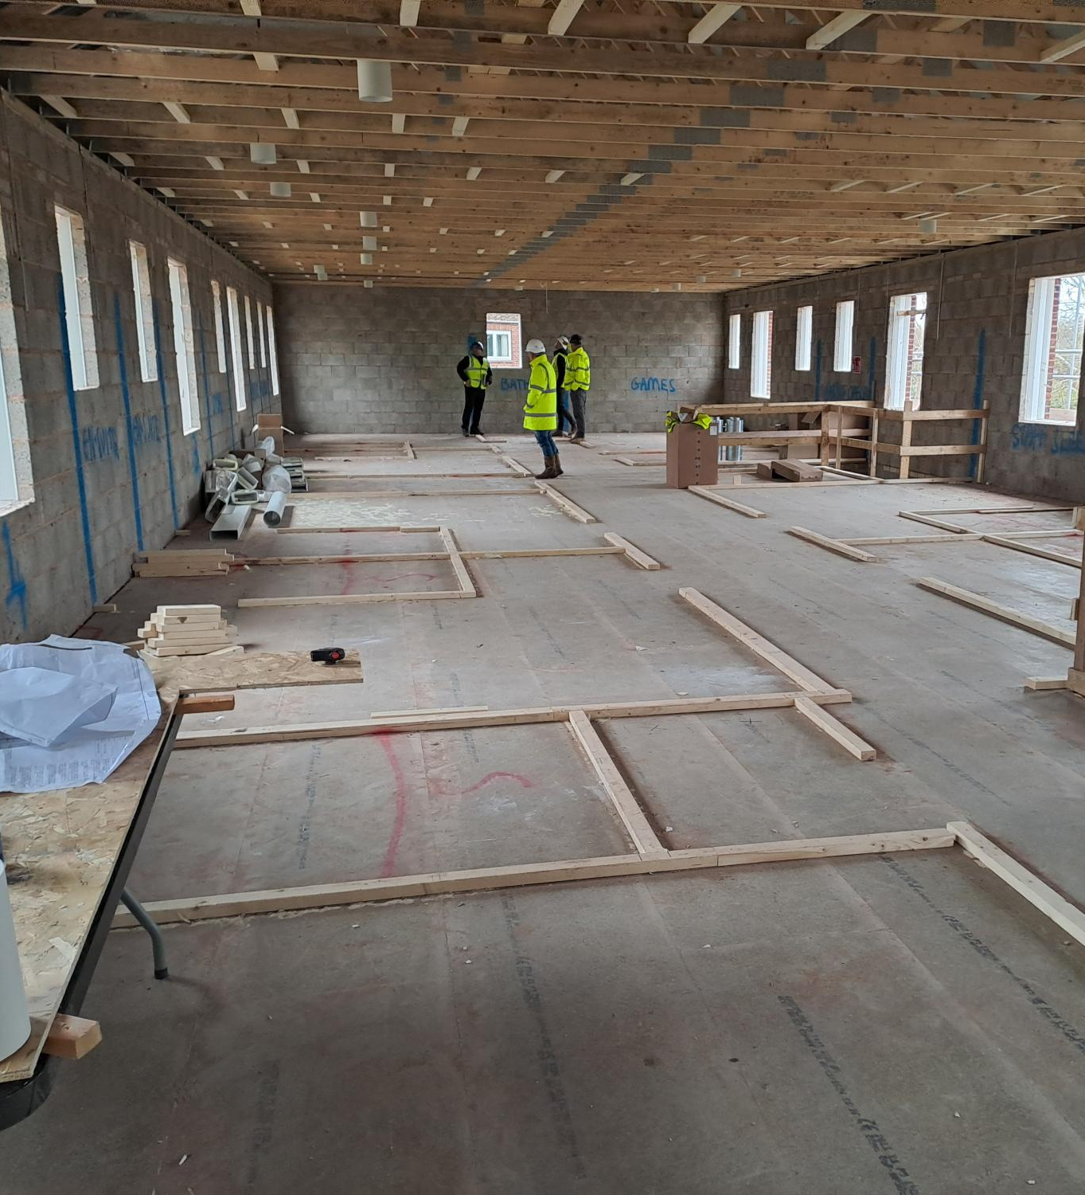
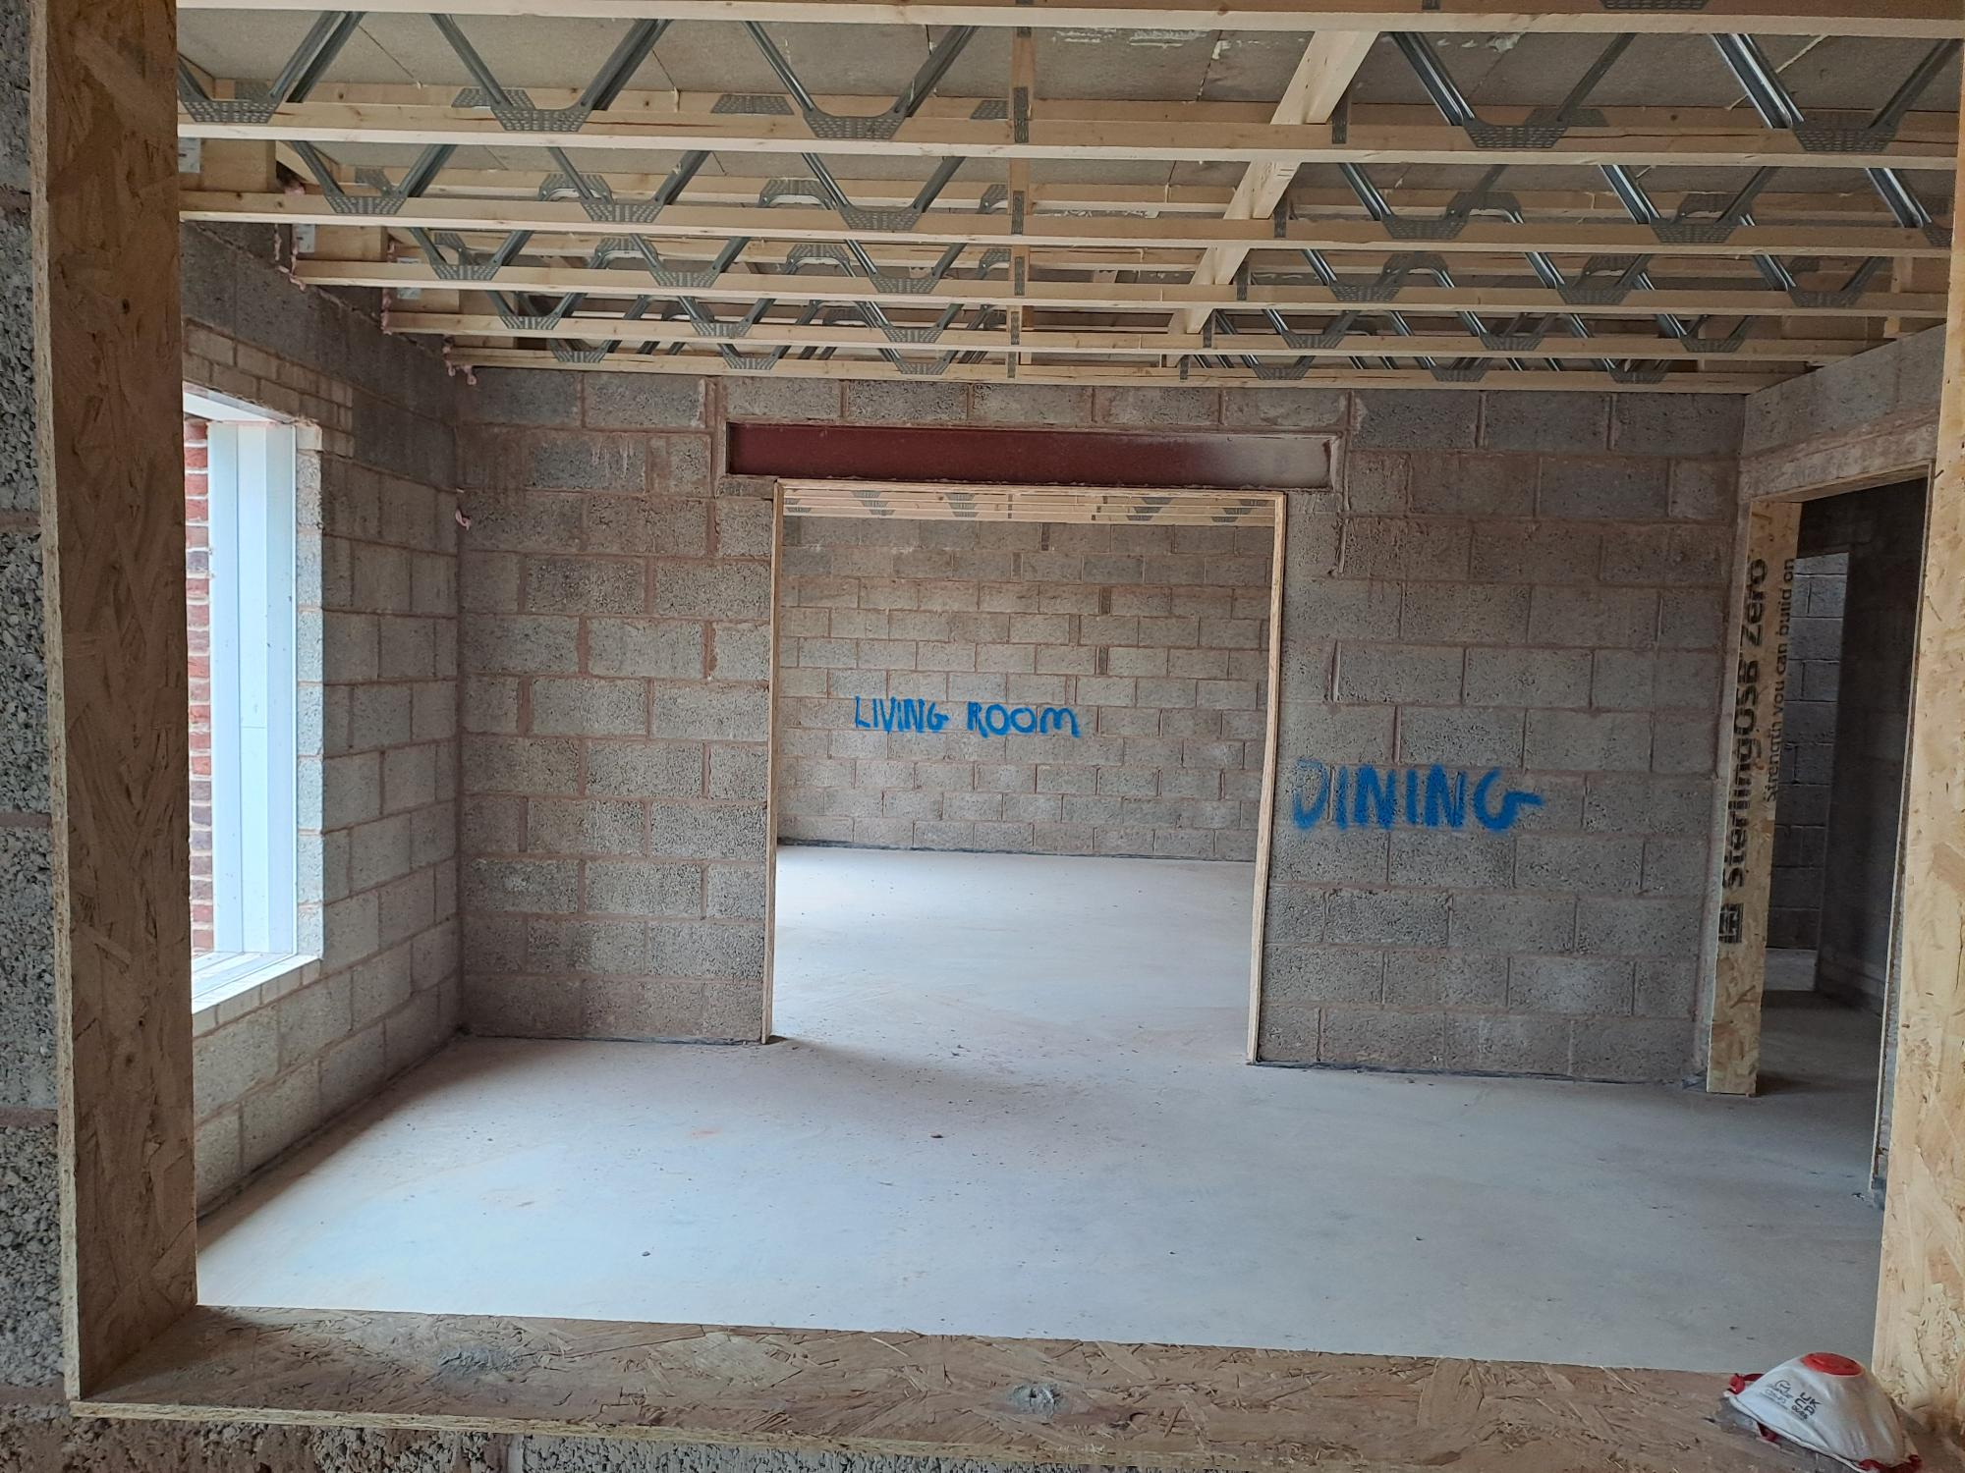
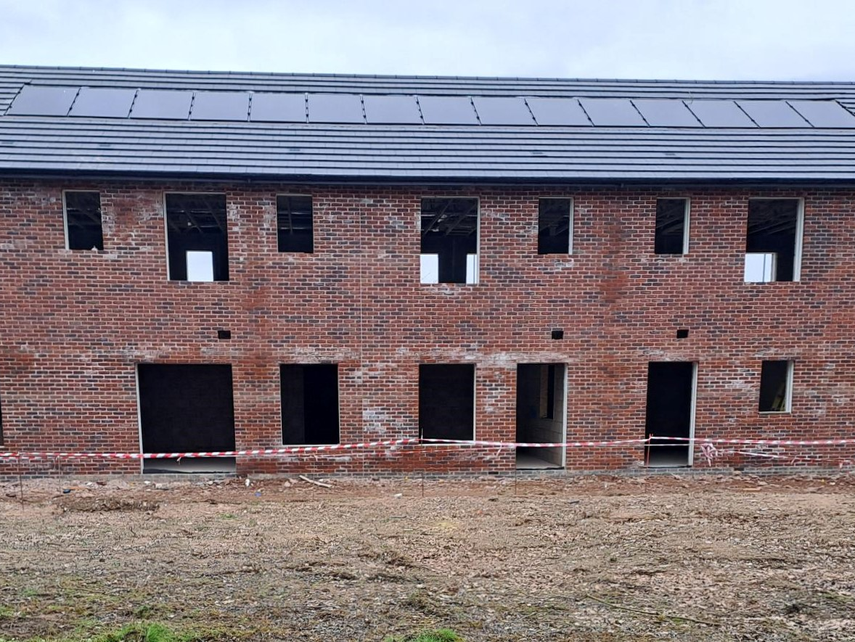
Hillview – Construction In Progress

Slide 18
Children Looked After Needs Analysis - Fostering
Most of our Children Looked After Live in Foster Care Households
Ratio of Leicester children living in Foster Care is above the national average
Majority of our Children in Foster Care are looked after by our own internal carers
Number of our children placed with internal carers is above average
Average cost of internal foster care household placement £340 per week
A smaller number of children cared for by Independent Fostering Agencies (IFAs)
Number of children living in Independent Fostering Agencies has increased
Number of children placed with IFA is still below the national average
Average cost of Independent Fostering Agency Placement £981 per week

Slide 19
Children Looked After Population Needs Analysis
Majority of children in foster care looked after by our own internal carers is reducing but remains above the average

Slide 20
Children Looked After Population Needs Analysis
Ratio of children living in foster care is down though above national average

Slide 21
Reducing our use of Independent Fostering Agencies

Slide 22
Enabling children to live locally in family households

